Slide 1
What if we did nothing? The future of The Bahamas without energy reform measures
Bahamas Chamber of Commerce and Employers’ Confederation
Nicola Virgill Rolle, PhD
Director
National Development and Planning

Slide 2
The Energy Situation Today
Island chain makeup and the commitment to bring electricity to every corner of The Bahamas
unified tariff system
Dependent on imported fossil fuels to meet energy needs.
Dependent on global oil prices
Continued price uncertainty given global trends
Balance of payments impacts
High cost of fuel per kilowatt-hour sold
High energy costs results in
Uncompetitive business environment
Reduces disposable household income
Serious impact of current technology on the environment
The need for renewable sources given issues of Climate Change

Slide 3
The Energy Situation Today
Reliability also appears to be an issue
forces many businesses and households to operate their own generators
Management issues:
High system losses,
Maintenance issues
High delinquency rates
There are few energy conservation measures
Power consumption can be reduced by as much as 25 per cent through more effective conservation and efficiency measures.
Some progress in the business sector
Needs national standards for efficiency

Slide 4
What does doing nothing look like?
Not addressing fossil fuel dependency
Not addressing inefficiencies to reduce energy costs to consumers
Continuing to contribute to CO₂ emissions, climate change and environmental damage
Not addressing management issues with respect to reliability, maintenance and delinquencies
Not addressing conservation and alternative energy

Slide 5
What does doing nothing look like?
Not addressing fossil fuel dependency
Not addressing inefficiencies to reduce energy costs to consumers
Continuing to contribute to CO₂ emissions, climate change and environmental damage
Not addressing management issues with respect to reliability, maintenance and delinquencies
Not addressing conservation and alternative energy
IMPOSSIBLE

Slide 6
Costs of Inaction: Inefficiencies in the economy
Welfare Impacts
Inefficiencies and high cost production result in huge deadweight loss in the economy as people pay more than they need to if supply side issues were addressed
Price of energy
Higher demand for fossil fuel based energy than is optimal because of lack of alternatives and conservation (suboptimal demand curve)
D₂
D₁
Quantity of Energy

Slide 7
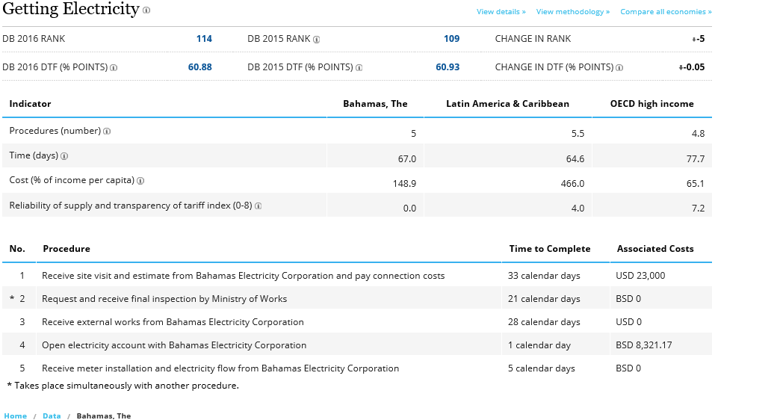
Cost of Inaction: Increases the cost of doing business

Slide 8
Cost of inaction: Continued declines in DBI
Overhead costs (fuel, operational costs)
Aging infrastructure, technology

Slide 9
Cost of Global Inaction on Climate Change
http://ase.tufts.edu/gdae/Pubs/rp/Caribbean-full-Eng.pdf

Slide 10
Cost of Inaction: Climate Impacts
http://www.ccrif.org/sites/default/files/publications/Bahamas_CountryRiskProfile_2013.pdf

Slide 11
National Energy Policy of The Bahamas
Bold policy announced with the National Energy Policy
Security of energy supply through diversification of fuels;
Modernizing the country’s energy infrastructure;
Development of renewable energy sources such as solar, ocean energy, biofuels, waste-to-energy and wind
Energy conservation and efficiency;
Development of a comprehensive governance/regulatory framework to effectively support the advancement of the energy sector to be effectively able to facilitate the introduction of renewables and the diversification of fuels; and
Eco-efficiency in the manufacturing, agricultural and tourism sectors and government as leaders in energy conservation and the use of renewable energy .

Slide 12
The Discussion should be about the pathway to action through an Evaluation of Priorities
comprehensive governance/regulatory framework to facilitate the introduction of renewables and the diversification of fuels
Modernizing the country’s energy infrastructure;
Development of renewable energy sources
Impact
diversification of fuels
Eco-efficiency and conservation and alternatives in the manufacturing, agricultural and tourism sectors
Energy conservation and efficiency
Cost

Slide 13
Questions

