Slide 1
The National Development Plan
National Development Plan Secretariat
7th January, 2016

Slide 2
A New Approach to Developments Planning in The Bahamas
Supported by new governance arrangements (Centre of Government - $50K) and IFMS loan ($3M)
$450K
Inclusive National Development
National Development Plan
Concluding work on the SNR, Nationwide Consultation commenced and drafting Vision 2040
Andros Master Plan
Sustainable Nassau
$1.1M
$750K
Pilot Project for Island Development
Pilot Project for Urban Development
Working towards ecosystem valuation, consultation, education and Master Plan
Baseline data, Diagnostic, Action Plan for the City of Nassau, Urban Lab planned

Slide 3
Key Reasons for a National Development Plan
No comprehensive, inclusive plan for The Bahamas
Public discourse of the future of The Bahamas was needed
Stable but moderate economic growth for years
Declining social trends which needed to be understood and stopped (education, healthcare, poverty)
Coordinated plan needed for public and private investment

Slide 4
Demographics are changing
Large working age population with potential for productive or unproductive activities
Population of The Bahamas by Age Groupings, Dept of Statistics

Slide 5
Global Downturn Affected Social Indicators
Poverty Indicators
Indicators | 2001 | 2013
Poverty Rate | 9.3 | 12.8
Poverty Line (per person per year) | $2,683 | $4,247
Population below poverty line | 27,800 | 43,000
Global Economic Downturn
Poverty Rates and Percent of The Poor and Poverty Gap by Island group: 2001, 2013
2001 |  |  | 2013
Regions | Poverty Rate | Poverty Gap | Regions | Poverty Rate | Poverty Gap
New Providence & Grand Bahama | 8.33 | 2.58 | New Providence | 12.58 | 3.32
 |  |  | Grand Bahama | 9.69 | 1.45
Abaco, Eleuthera, & Andros | 13.19 | 3.73 | Abaco | 20.32 | 5.75
 |  |  | Andros and Eleuthera | 17.33 | 5.48
Exuma & Long Island | 16.64 | 5 | Exuma and Long Island | 14.71 | 4.61
Other Family Islands | 20.96 | 6.35 | Other Family Islands | 11.44 | 0.82

Slide 6
Doing Business Priorities 2016
Registering Property (#183) – Process Reform
Getting Credit (#133)- Institutional Reform
Starting a Business (#118)- Process Reform
Getting electricity (#114) – Process Reform
Trading Across Borders (#97) – Process Reform
Dealing with Construction Permits (#94)- Process Reform
Resolving Insolvency (#61) – Legislative Reform
Enforcing Contracts (#60) – Process and Legislative Reform
Paying taxes (#24)- Continued Process Improvement
Protecting Minority Investors (#111)- Legislative Reform
Green outline indicates that there are improvements underway
6

Slide 7
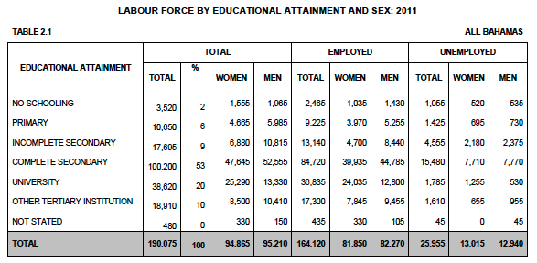
Education Matters in Defining Vulnerability
26%
15%
4%
9%

Slide 8
Does The Bahamas Need a
National Development Plan?
Source: World Bank Development Indicators

Slide 9
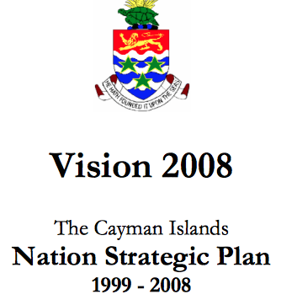
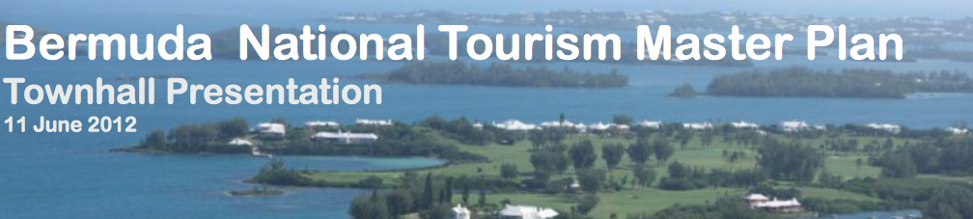

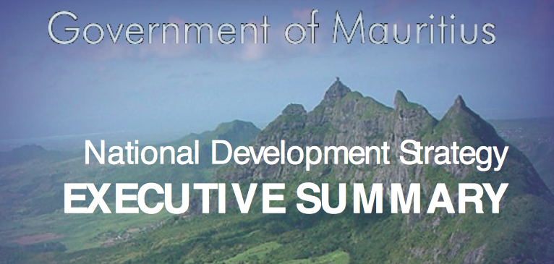

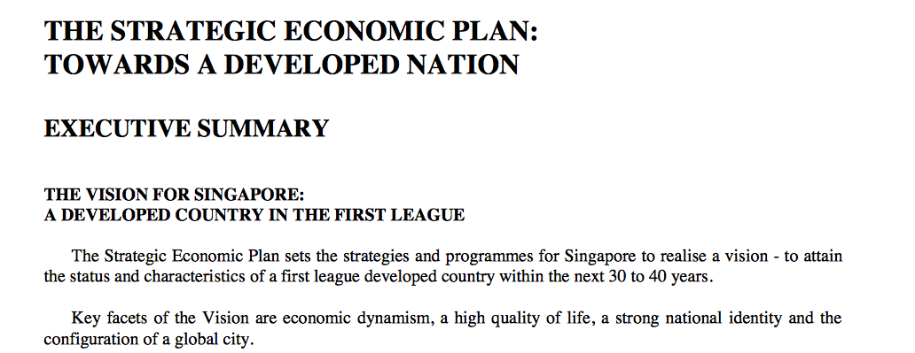

Slide 10

VISION 2040:
A PHASED APPROACH
1.
2.
3.
DIAGNOSTIC
CONSULTATIVE
FORMULATION
AND DRAFTING
A comprehensive analysis
of the current state of
The Bahamas
Socio-Economic Physical and Environmental Assessment
Institutional and Governance Assessment
THE STATE OF THE
NATION REPORT
Visioning & Strategy Workshops
Family Island Engagements
Stakeholder Meetings
Ministerial & National Surveys
National Youth Conference
Engagement Through the Arts
THESE WILL SERVE AS ROUTES THROUGH WHICH TO RECEIVE STAKEHOLDER INPUT
Creation of national vision and
strategy documents, using the
inputs and ideas of the Bahamian stakeholders and people
COLLATING IDEAS AND INPUTS
INTO A COMPREHENSIVE DOCUMENT THAT WILL BECOME
THE NATIONAL DEVELOPMENT PLAN

Slide 11
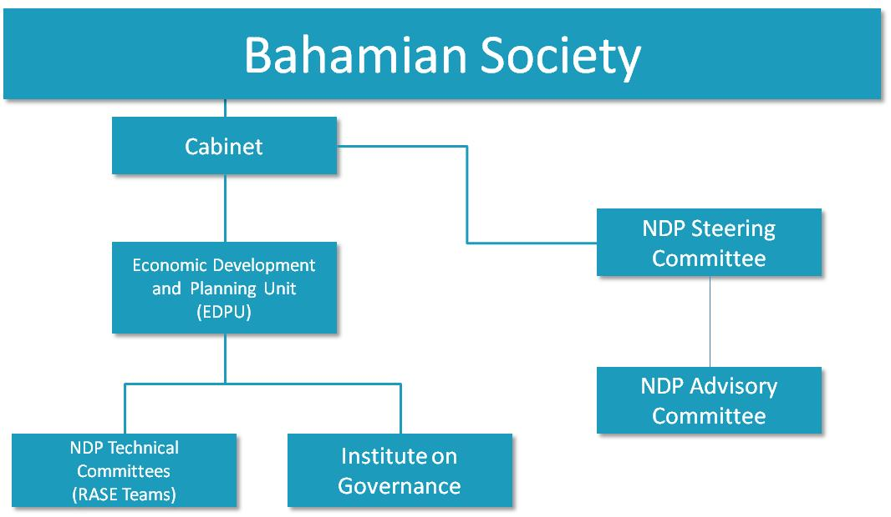
Project Governance
College of The Bahamas

Slide 12
Phase 1 NDP:
State of the Nation Report
The Economy
Descriptive: what drives the Bahamian economy, how are sectors performing
Defining The Bahamas’ competitiveness (what are our endowments, where have clusters developed, what are our strengths)
Forward looking: where is the growth potential globally and where does The Bahamas fit in?
Governance
How can government work better?
Public sector coordination
Public sector mission definition
How does the government interact with its citizens
Environment (Built and Natural)
Consideration of aspects of the infrastructure needed to build a modern economy (built environment)
Energy, transportation, ICT (facilitative environment)
Natural Environment (within the context of climate change)
Human Capital/ Social Policy
Education, Labour
Issues of poverty, gender, culture, other societal factors
Health and healthcare, impacts on the future of the country
Crime and justice
Public service effectiveness

Slide 13
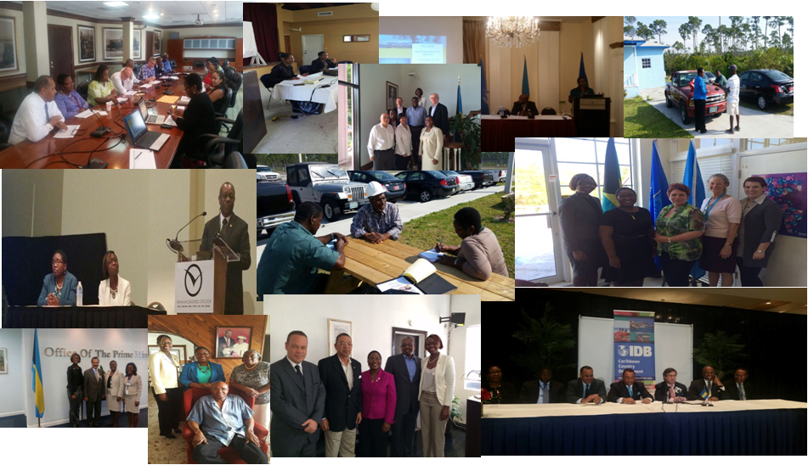
Phase 2 NDP: Community Engagement & Awareness Campaigns

Slide 14
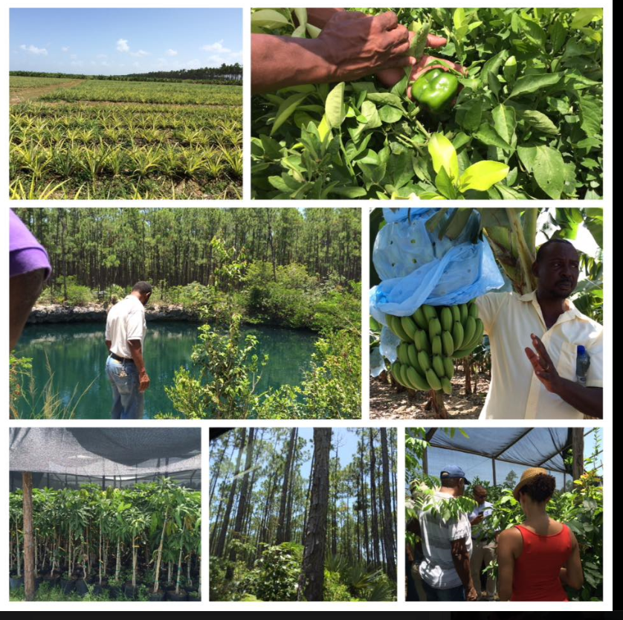
North Andros Engagement

Slide 15
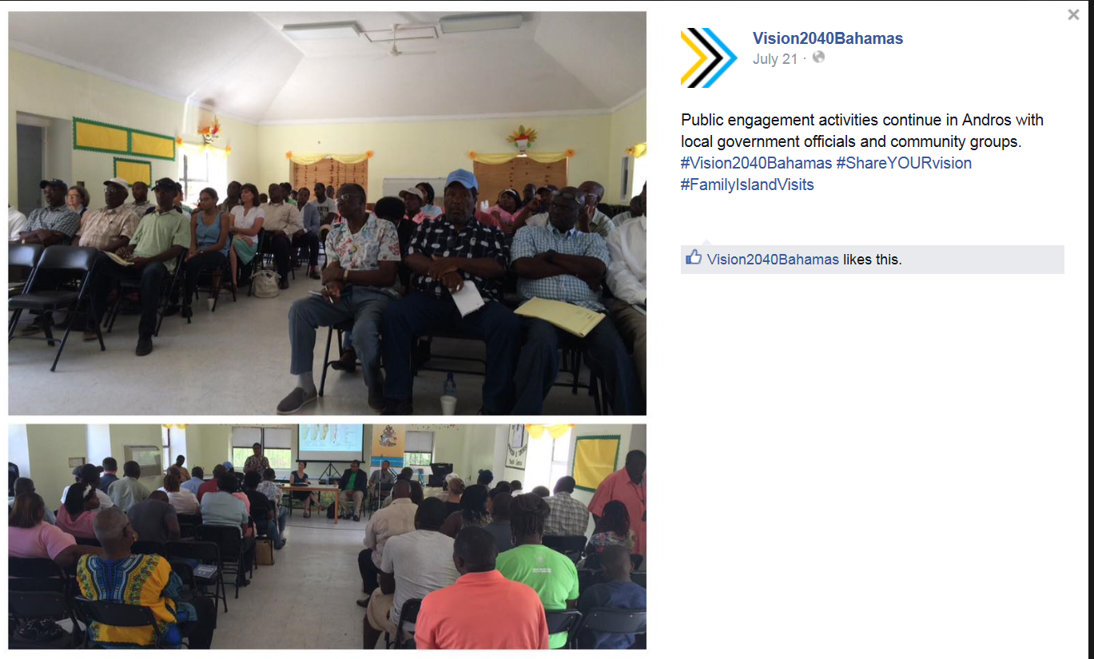
South Andros Engagement

Slide 16
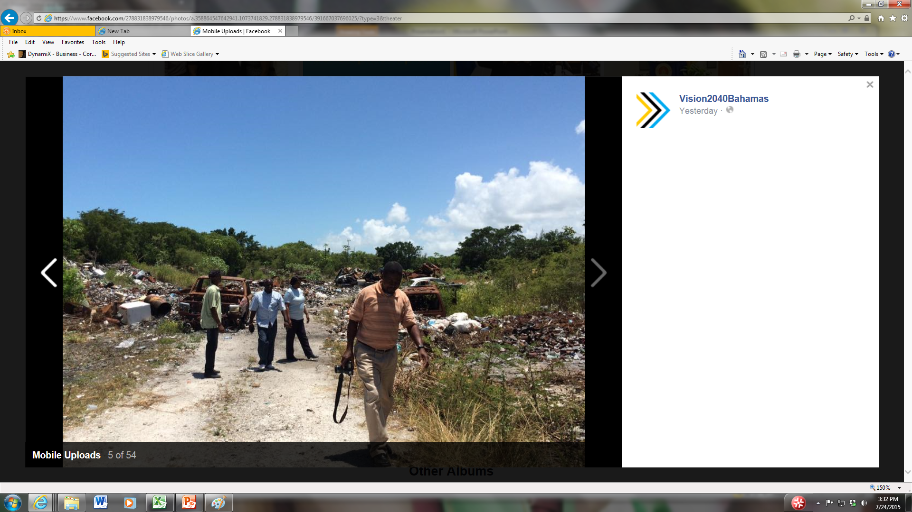
South Andros Landfill

Slide 17
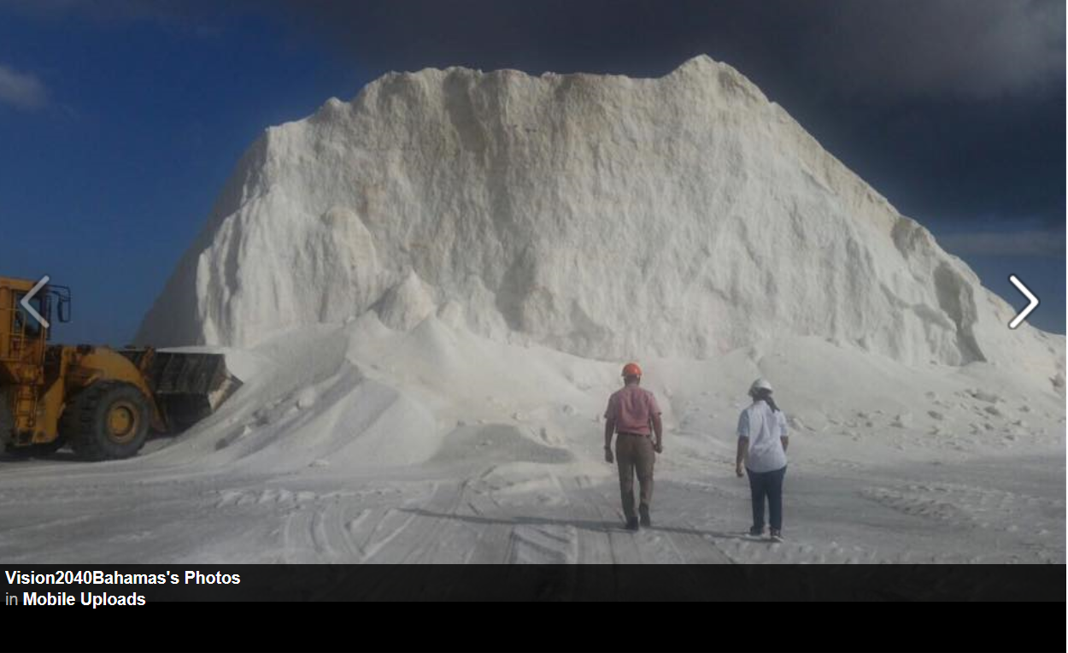
Inagua

Slide 18
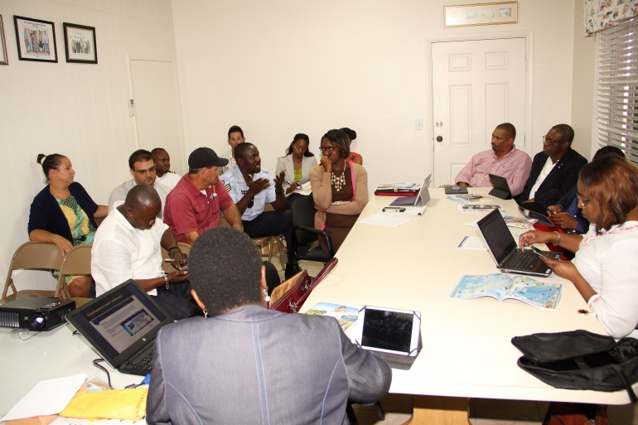
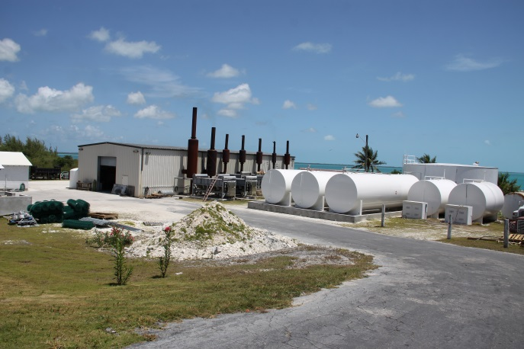
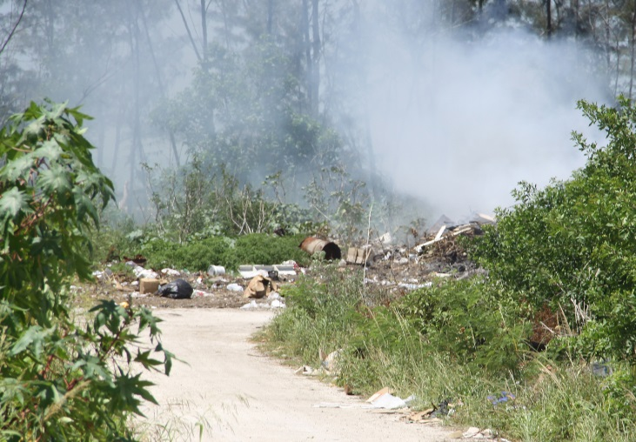
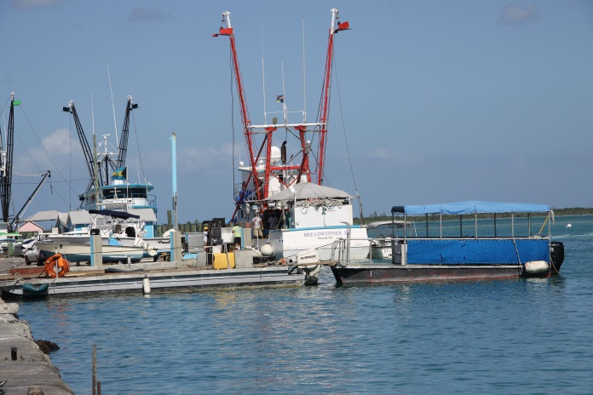
Spanish Wells, Eleuthera

Slide 19
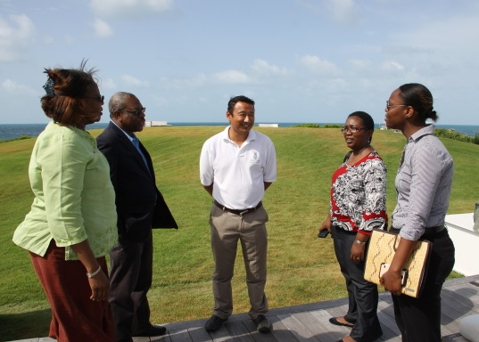
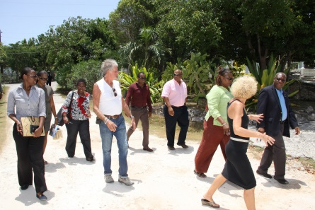
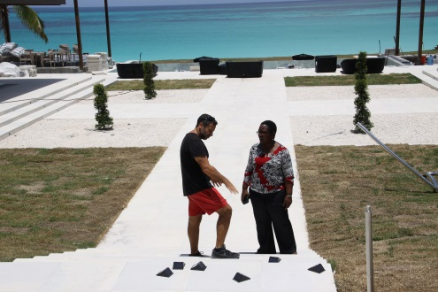
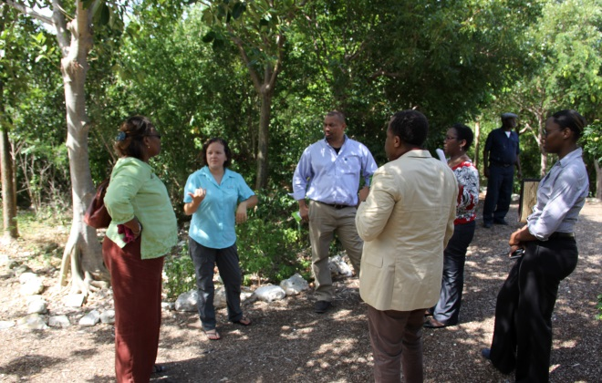
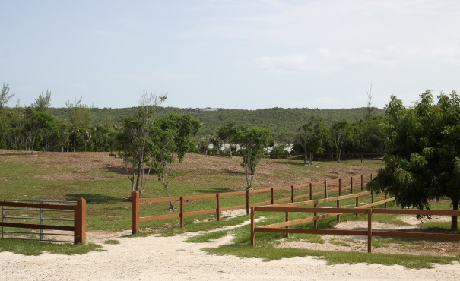
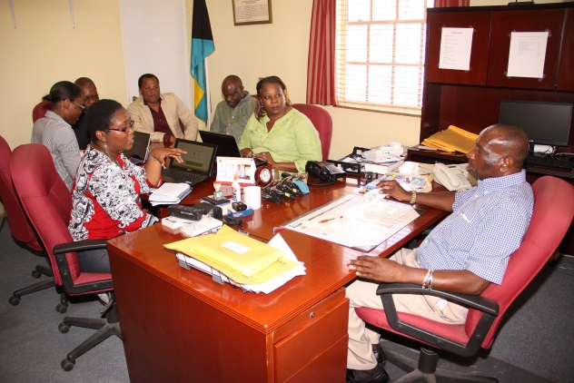
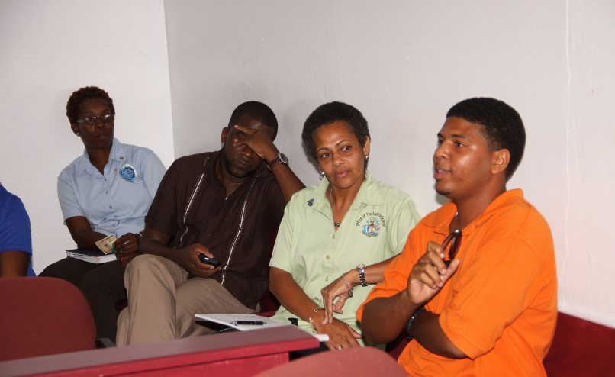
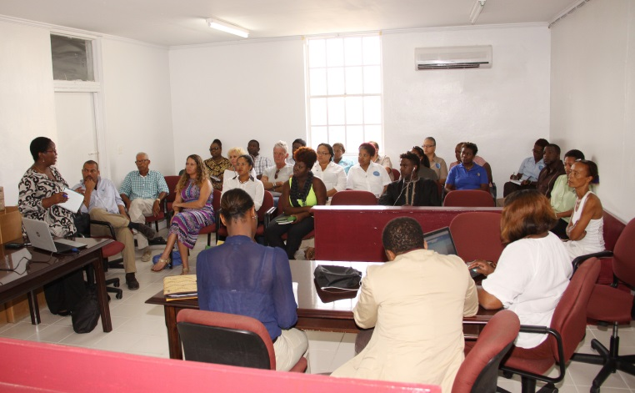
Governor’s Harbour

Slide 20
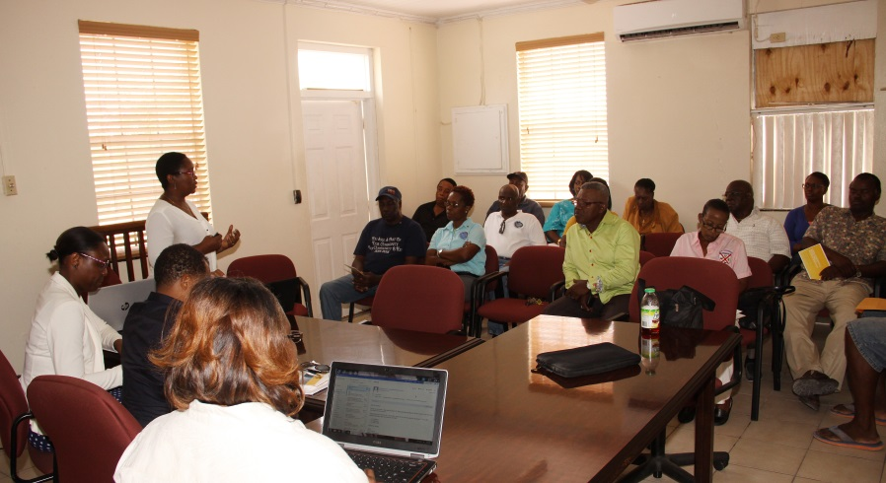
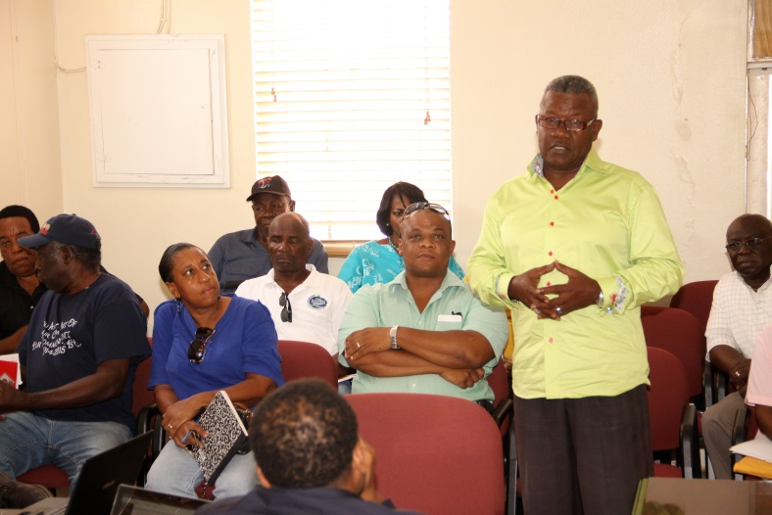
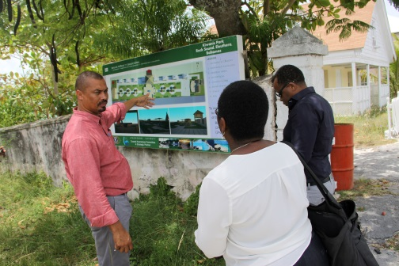
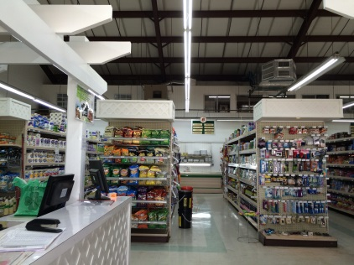
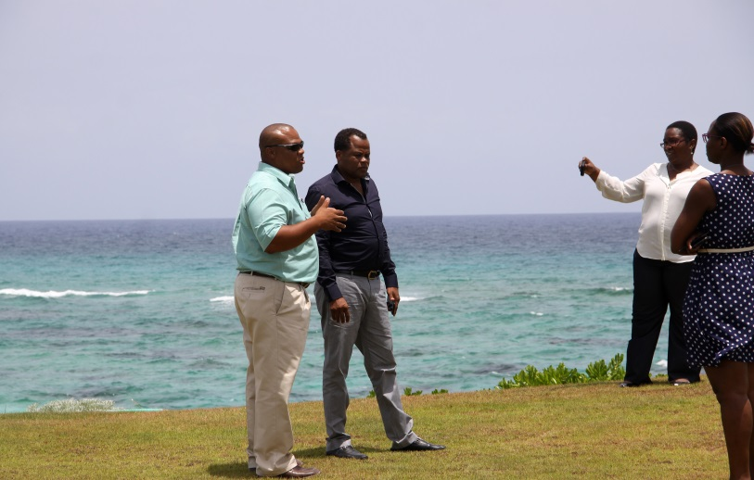
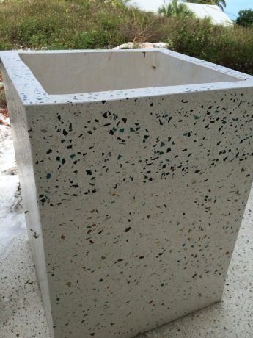
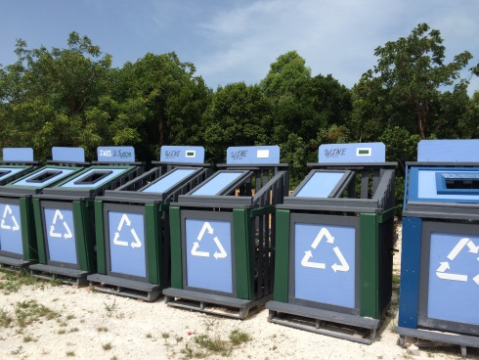
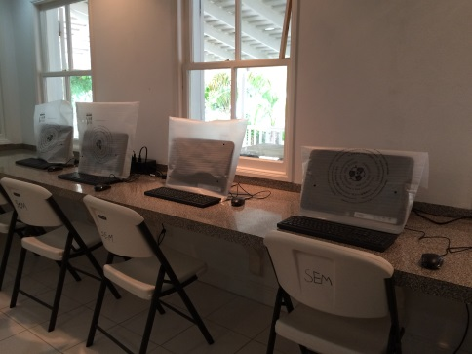
Rock Sound, Eleuthera

Slide 21
Phase 3: Completion of the National Development Plan
Roadmap for the future
Vision for The Bahamas
Identify short, medium and long term goals and strategies
Key indicators of success
Be monitored

Slide 22
Project Risks
KEYS TO SUCCESSFUL
IMPLEMENTATION OF PROJECT
RISK:
IMPLEMENTATION OF THE POLICY REFORM
NECESSARY TO INSTITUTIONALIZE PLANNING
Major change in public policy formulation processes in The Bahamas (operational, cultural)
MITIGANT ONE:
CENTRE OF GOVERNMENT APPROACH TO THE PLANNING
Within the Office of the Prime Minister (OPM) and will be legislated
Development of a planning and implementation monitoring tool and a governance mechanism to ensure that planning and execution occurs
MITIGANT TWO:
WIDE CONSULTATION AND STAKEHOLDER APPROACH
Our job is to ensure that all stakeholders understand that this planning approach
and the execution of the agreed plan is vital for the future of The Bahamas
MITIGANT THREE:
BUILD CAPACITY IN PLANNING AND ENSURE THAT THERE IS A
“STRATEGIC PLANNING SPACE” IN PUBLIC ADMINISTRATION

Slide 23
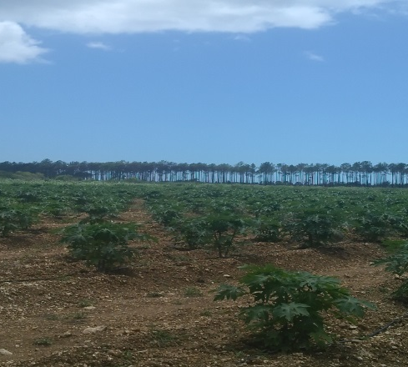
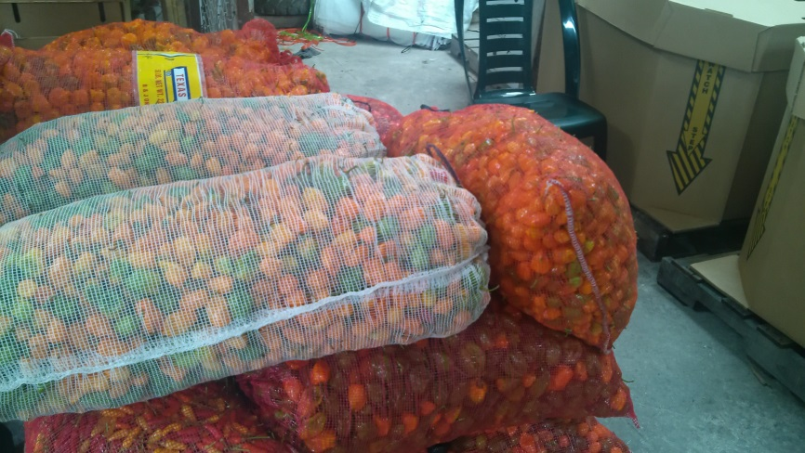
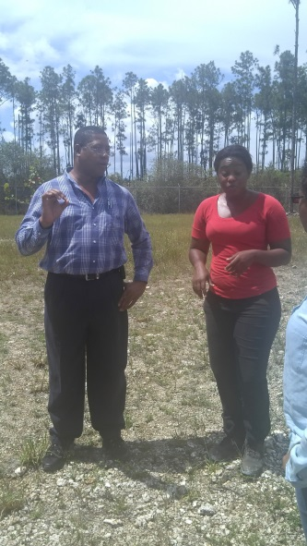
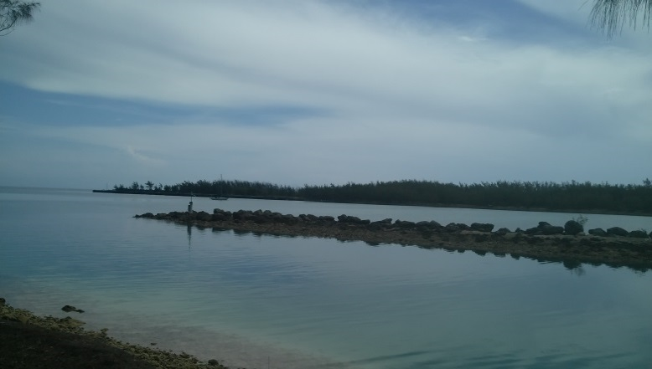
Andros Ecosytem Services Master Plan
  Measurement of economic value of Andros ecosystem services
Developing realistic development scenario with Androsians
Assess alternative development scenarios (tradeoffs) for Andros based on the islands natural capital and climate resilient coastal zone management
Propose a viable physical development plan which optimizes the economic value of natural capital through sustainable use.
Agreement signed February 2018
TAC formed and active
NatCap working to get baseline data from TAC and other stakeholders
Engaging two other consulting firms
  Local stakeholder engagement and education
  Masterplan

Slide 24
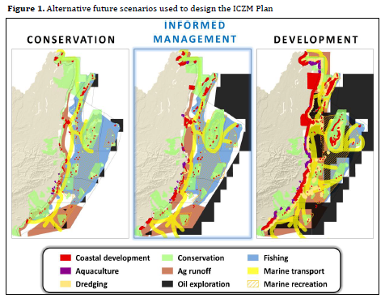
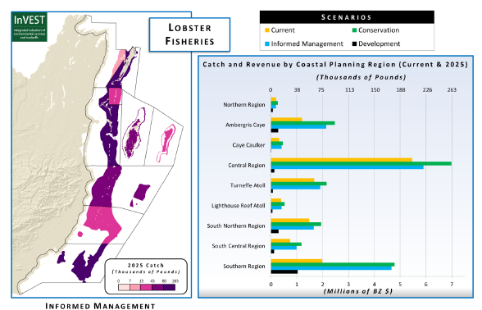
Example from Belize
http://www.naturalcapitalproject.org/pubs/Belize_InVEST_scenarios_case_study.pdf

Slide 25
Expected outcomes from Andros Project
Understand the valuation of Andros’ natural and social resources
Explore the various development scenarios for Andros and understand the trade offs
  If I develop this, I lose this, etc
Make a decision about a development path for Andros (North, Central, South)
Understand the costs of development and infrastructure.
Template of other island planning

Slide 26
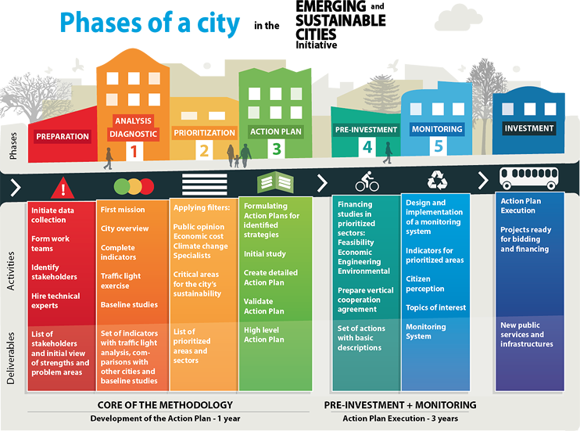
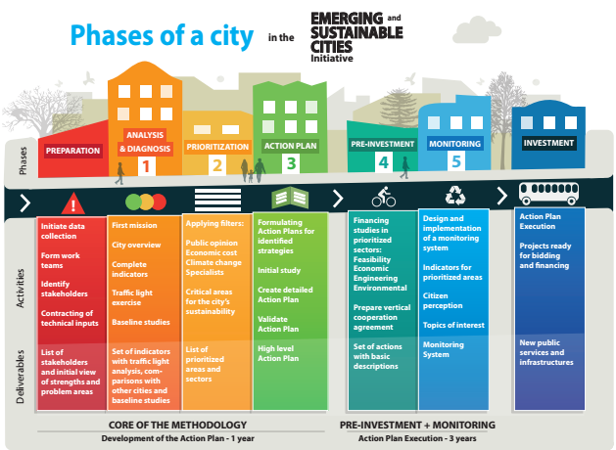
Sustainable Nassau Project
Source: IDB http://www.iadb.org/en/topics/emerging-and-sustainable-cities/implementing-the-emerging-and-sustainable-cities-initiative-approach,7641.html

Slide 27
Expected outcomes of Sustainable Nassau Project
Effectively plan for an increasingly urbanized Nassau
  Sanitation, transportation, urban development and housing, citizen security
Coordinate with other initiatives
  Historic Charlestown, Downtown initiative
Improve the wellbeing of Nassauvians

Slide 28
An integrated system of development for The Bahamas
Centre of Government
National Development Plan
Island Masterplans
Nassau Masterplan

